Slide 1

MATSim User Meeting 17 June 2024 The Feeder DRT extension: enabling simulation of intermodal mod systems
Tarek CHOUAKI | tarek.chouaki@irt-systemx.fr
Researcher @ IRT SystemX
Sebastian HORL | sebastian.horl@irt-systemx.fr
Researcher @ IRT SystemX
16.06.24 | Slide 1

Slide 2
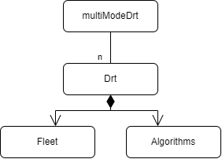
Introduction: The DRT Module
MATSim supports the simulation of on-demand mobility systems thanks to the DRT module
Vehicle fleet and passenger interaction simulation
Vehicle assignment algorithm supporting ride-sharing with operational constraints
Maximum wait time
Maximum detour
Various algorithms for empty vehicle rebalancing
Many recent developments
Prebooking
Grouped requests
User specific stop duration
Various MoD systems can be configured and simulated independently from each other (multiModeDrt)
The fleets, algorithms and operational constraints are proper to each service
16.06.24 | Slide 2

Slide 3
Introduction: Intermodality in public transport
MATSim’s transit module allows to simulate public transports (PT)
The SwissRailRaptor algorithm is in charge of computing PT routes
Existing functionality allows to configure access and egress modes that are considered by the algorithm
Typically walking
But also DRT
16.06.24 | Slide 3

Slide 4
Introduction: Intermodality in public transport
MATSim’s transit module allows to simulate public transports (PT)
The SwissRailRaptor algorithm is in charge of computing PT routes
Existing functionality allows to configure access and egress modes that are considered by the algorithm
Typically walking
But also DRT
However:
When different access and egress modes are available, the choice of what mode to use happens in the routing level, optimizing travel time
In some cases, we need this choice to happen in the mode choice level (replanning) by considering each access/egress alternative as an independent main mode
The contribution at hand makes this relatively easy.
16.06.24 | Slide 4

Slide 5
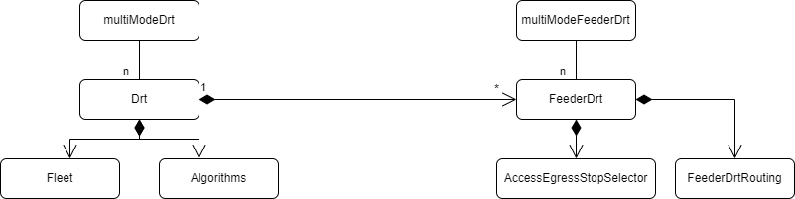
Extension implementation: General overview
Inspired by the architecture of the DRT module
A multiModeFeederDrt module allowing to define many feederDrt services
Each FeederDrt module wraps a DRT service defined by a Drt module
A FeederDrt module relies on two main components:
A FeederDrtRouting module
An AccessEgressStopSelector (hidden behind an interface)
16.06.24 | Slide 5

Slide 6
Extension implementation: Routing
The FeederDrtRouting module operates in the following steps
16.06.24 | Slide 6

Slide 7
Extension implementation: Routing
The FeederDrtRouting module operates in the following steps
Relying on the AccessEgressStopSelector to identify up to two stops where the user will switch between DRT and PT
16.06.24 | Slide 7

Slide 8
Extension implementation: Routing
The FeederDrtRouting module operates in the following steps
Relying on the AccessEgressStopSelector to identify up to two stops where the user will switch between DRT and PT
Building the segments by using the respective DRT and PT routers
16.06.24 | Slide 8

Slide 9
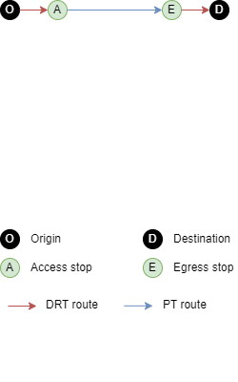
Extension implementation: Routing
The FeederDrtRouting module operates in the following steps
Relying on the AccessEgressStopSelector to identify up to two stops where the user will switch between DRT and PT
Building the segments by using the respective DRT and PT routers
16.06.24 | Slide 9

Slide 10
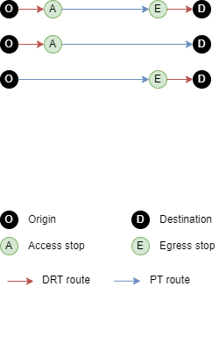
Extension implementation: Routing
The FeederDrtRouting module operates in the following steps
Relying on the AccessEgressStopSelector to identify up to two stops where the user will switch between DRT and PT
Building the segments by using the respective DRT and PT routers
Handling cases where only of access and egress stops is found
If neither is found, the route computation will fail
We consider that the PT with regular walk access and egress is still available
16.06.24 | Slide 10

Slide 11
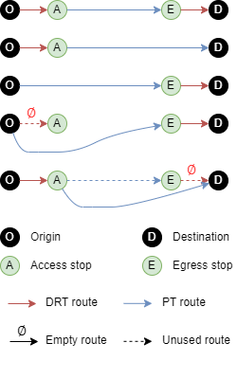
Extension implementation: Routing
The FeederDrtRouting module operates in the following steps
Relying on the AccessEgressStopSelector to identify up to two stops where the user will switch between DRT and PT
Building the segments by using the respective DRT and PT routers
Handling cases where only of access and egress stops is found
If neither is found, the route computation will fail
We consider that the PT with regular walk access and egress is still available
Handling cases where the DRT router gives an empty route
Same as above, if both DRT routes are empty, the route computation fails.
16.06.24 | Slide 11

Slide 12
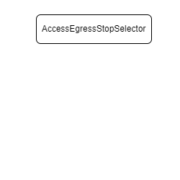
Extension implementation: Access and Egress stop selection
The Access and Egress stops selection is hidden behind an interface
Allowing to extend it further with custom selection processes
16.06.24 | Slide 12

Slide 13
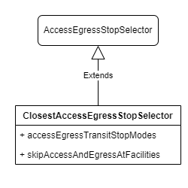
Extension implementation: Access and Egress stop selection
The Access and Egress stops selection is hidden behind an interface
Allowing to extend it further with custom selection processes
Default implementation consists in ClosestAccessEgressStopSelector, it allows to:
Define the transit modes of the stations where intramodality can happen: e.g. rail and tram only
Prevent the user of DRT for access or egress based on the facility at the adjacent border of the trip (origin or destination)
This implementation uses pre-computed QuadTree objects to efficiently find access and egress stops
16.06.24 | Slide 13

Slide 14
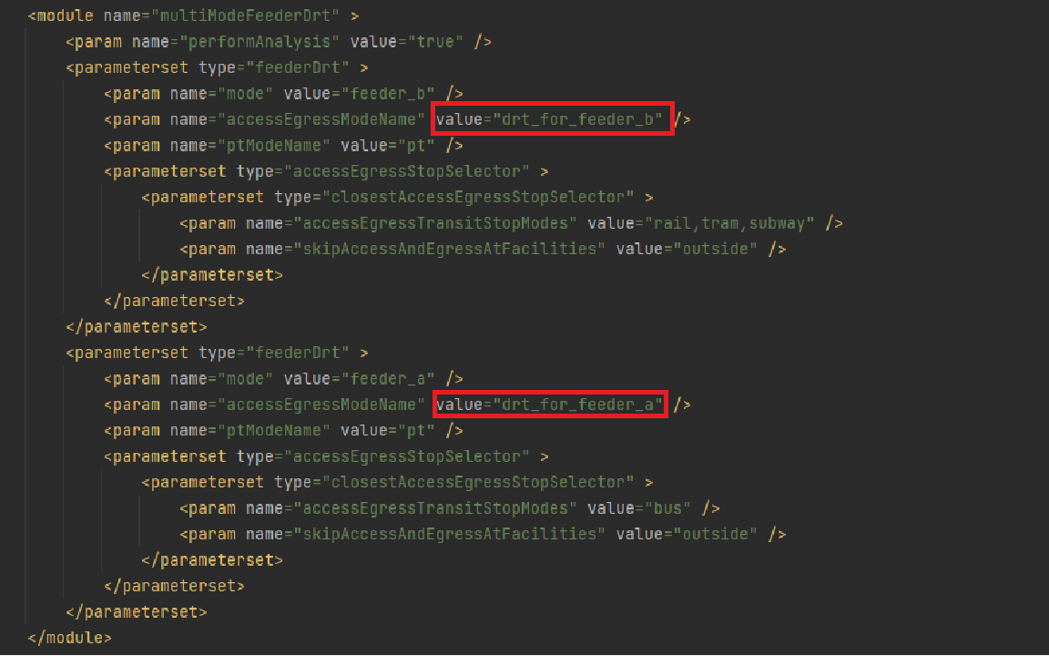
Extension implementation: Usage
The Access and Egress stops selection is hidden behind an interface
Allowing to extend it further with custom selection processes
Default implementation consists in ClosestAccessEgressStopSelector, it allows to:
Define the transit modes of the stations where intramodality can happen: e.g. rail and tram only
Prevent the user of DRT for access or egress based on the facility at the adjacent border of the trip (origin or destination)
This implementation uses pre-computed QuadTree objects to efficiently find access and egress stops
16.06.24 | Slide 14

Slide 15
Extension implementation: Usage
By configuring the mode choice, it is possible to:
Have two feederDrt systems use the same DRT fleet
Have a DRT fleet used both as a feeder and as a standalone
This module is currently integrated in the Eqasim framework
Relying on Discrete Choice Models for mode choice
The following example is built on this framework
16.06.24 | Slide 15

Slide 16
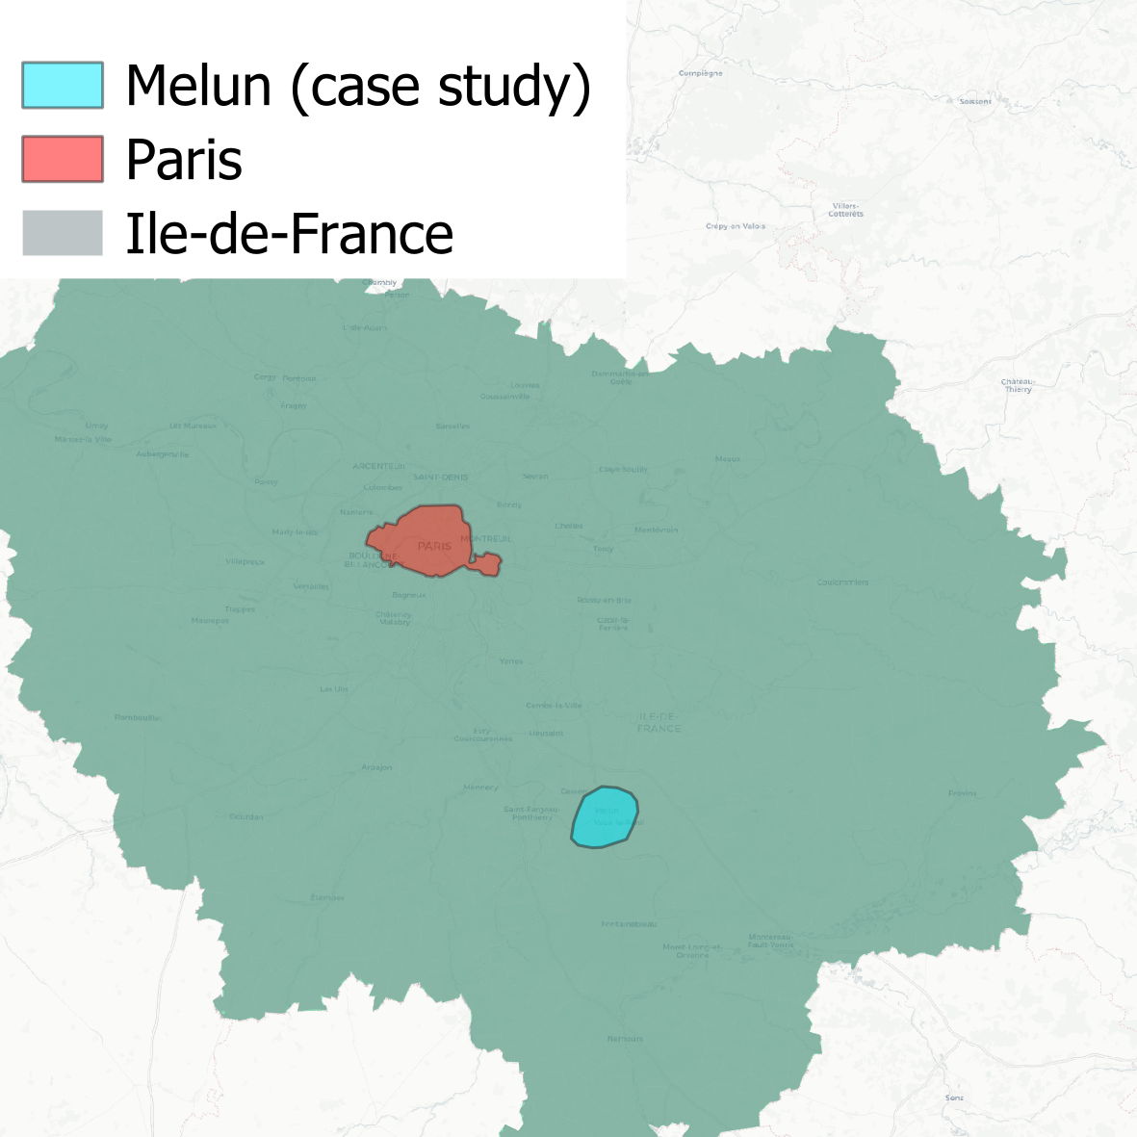
A simple case study: standalone and feeder drt at once
Case study:
Melun: A peri-urban area in the Paris region
162K travelers per day
Resulting from a realistic synthetic population
For the whole region
Built from open data
Fully reproducible
10% sampling
16.06.24 | Slide 16

Slide 17
A simple case study: standalone and feeder drt at once
Case study:
Melun: A peri-urban area in the Paris region
162K travelers per day
Resulting from a realistic synthetic population
For the whole region
Built from open data
Fully reproducible
10% sampling
The region-level simulation is “cut” :
Keeping only agents that travel in the area during the day
Introducing some mode-choice related constraints
16.06.24 | Slide 17

Slide 18
A simple case study: standalone and feeder drt at once
Service definition:
A Standalone DRT service defined as usual using the DRT module
50 vehicles, door2door…
A FeederDrt module using the same fleet:
Allowing intermodality only at rail stations
16.06.24 | Slide 18

Slide 19
A simple case study: standalone and feeder drt at once
Service definition:
A Standalone DRT service defined as usual using the DRT module
50 vehicles, door2door…
A FeederDrt module using the same fleet:
Allowing intermodality only at rail stations
Mode choice consideration
Utility functions for DRT and FeederDrt extend the utility function of PT
The DRT service is free for all users
Trips that enter or leave the area are prevented from changing modes
Except: PT trips can change to FeederDrt trips as long as no DRT leg is inserted at the border
Ensured using the skipAccessAndEgressAtFacilities parameter
16.06.24 | Slide 19

Slide 20
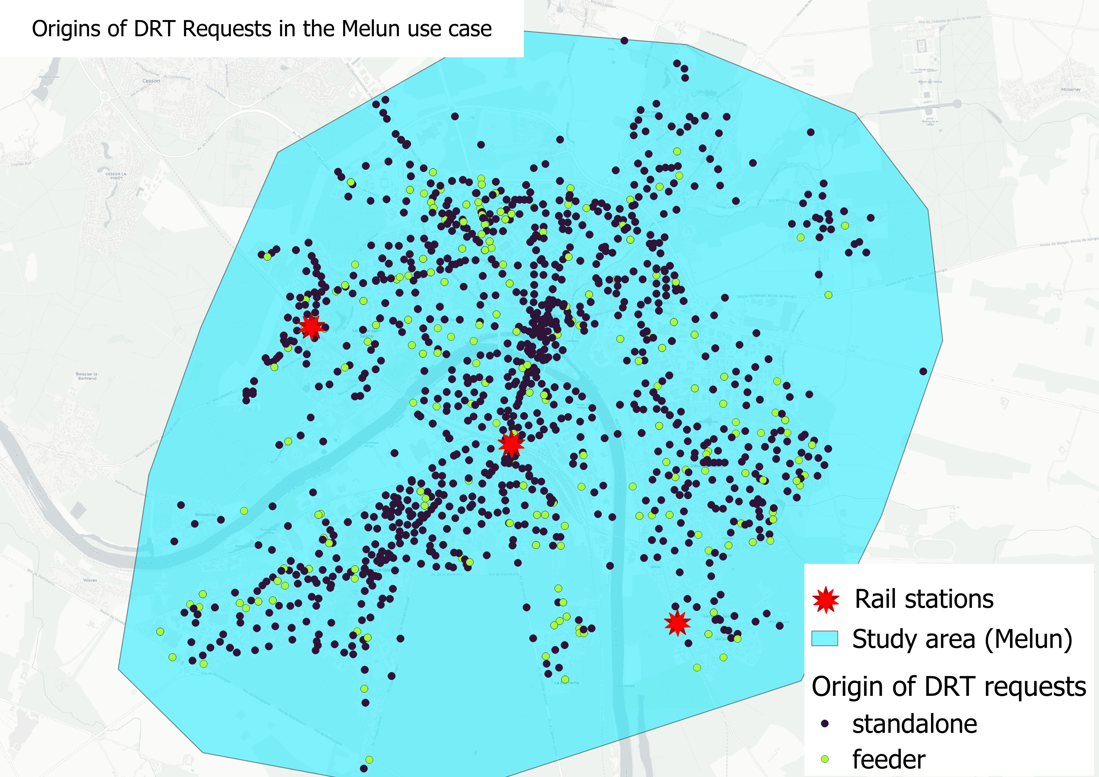
A simple case study: standalone and feeder drt at once
Results:
The demand for both standalone and feeder DRT are well distributed in the area
16.06.24 | Slide 20

Slide 21
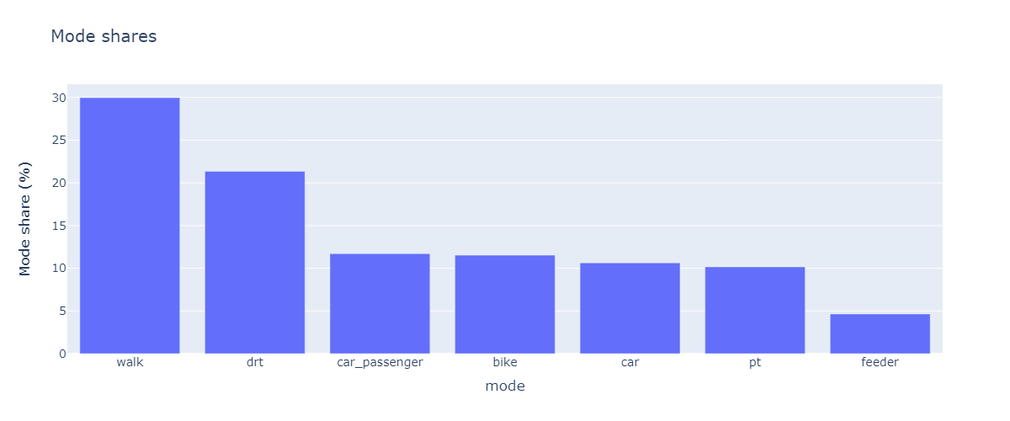
A simple case study: standalone and feeder drt at once
Results:
The demand for both standalone and feeder DRT are well distributed in the area
PT equipped with feeder DRT represents an interesting alternative to regular PT
Under the simulated cost parameters, standalone DRT outperforms car and PT
16.06.24 | Slide 21

Slide 22
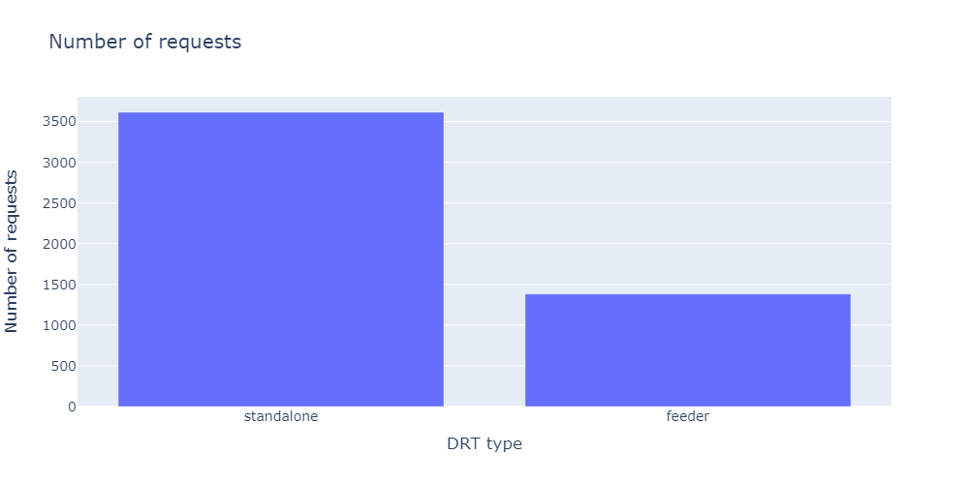
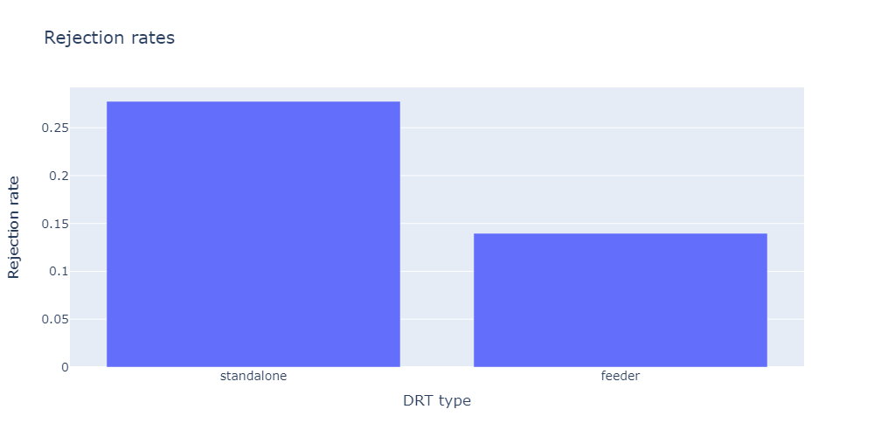
A simple case study: standalone and feeder drt at once
Results:
The demand for both standalone and feeder DRT are well distributed in the area
PT equipped with feeder DRT represents an interesting alternative to regular PT
Under the simulated cost parameters, standalone DRT outperforms car and PT
Even if all requests go to the same fleets, rejection rates can be different
16.06.24 | Slide 22

Slide 23
Conclusion
The FeederDrt extension allows to easily simulate intermodal MoD systems
It enables a competition between PT using intermodal DRT and PT not using it at the mode choice level
The current routing is rather simple yet highly extensible
The module is currently used in an extensive study on intermodal MoD systems (following presentation by Tatiana Seregina)
The current code base is generic enough to allow the combination of PT with any other mode
Perspectives
Enhance the code documentation
Submit a PR of the extension to the MATSim-libs
As an intermodal contrib allowing PT to be chained with any other mode
Implement more elaborate access egress stop finders
16.06.24 | Slide 23

Slide 24
Thank you
Tarek CHOUAKI | tarek.chouaki@irt-systemx.fr
16.06.24 | Slide 24

